Slide 1



Fueling India's Digital Drive
Instant QR payments at petrol pumps, eliminating cash hassles, queues, and fraud.
Our vision: to digitize 85,000+ outlets nationwide.

Slide 2






The Fuel Retail Pain Points
Operational Inefficiency
Revenue Leakage
The Digital Gap
Shrinkage and pilferage silently erode the 3-5% dealer margin, directly threatening the profitability and sustainability of the retail outlet's daily operations.
Urban pumps selling 8,000 to 20,000 litres daily still lack the swift, automated digital rails required to handle massive traffic with zero friction and absolute reliability.
Drivers waste minutes counting change while staff handle soiled cash, causing queues that spill onto roads. UPIs and QR payments are often obstructed by internet connections, leading to severe delays.

Slide 3
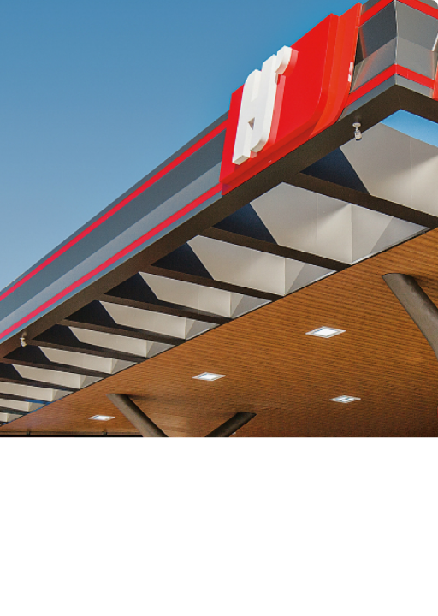
Hyperlocal & Speed First
Zero-Wait Experience
Enhanced Security
Autopay convenience for a seamless drive-in and drive-out journey.
Vehicle-linked tracking and digital receipts for complete transparency and trust.
Scalable Pilot Model
Zero POS Hardware
Starting with a dense pilot across 10-20 pumps to perfect the rapid payment model.
No bulky terminals required. The ecosystem is entirely mobile and QR driven.
Eradicate Queues
RBI-Compliant Rails
Eliminate cash hassles, exact change problems, and long waiting lines.
Built on secure, standard UPI networks ensuring 100% compliance and reliability.

Slide 4



Size & Scalability
We don't scale by adding hardware (which increases friction). We scale by replicating dense micro-zones.
TAM
(55,000 Pumps)
Total Fuel Retail Infrastructure
The total addressable market encompasses all petrol pumps nationwide.
SAM
(40,000 Urban Pumps)
₹87.5L to ₹2.2Cr Daily Profit Pool
Around 8.5 M litres of cashless sales daily. Impulse and quick-refuel segments suited perfectly.
SOM
(0.86M Litres/day)
₹4.3L Daily Revenue
Capturing 10% of urban cashless market at 0.5% transaction fee.

Slide 5
The Micro-Economics of a Single Pump
A look at the daily economics for an average urban petrol pump and ZapPay's value proposition.
Metrics
Current State (Avg. Urban Pump)
With ZapPay (20% Target)
Daily Volume
Litres dispensed daily
12,000 L
High friction mixed payments
2,400 L
Zero-friction automated volume
Financial Throughput
Gross Profit vs Txn Value
₹40,800
Dealer Gross Profit (~3-5%)
₹2.4 L
Total Txn Value Processed
ZapPay Revenue
At 0.5% transaction fee
-
₹1,200 / day
₹4.4 L Annual Revenue per Pump

Slide 6


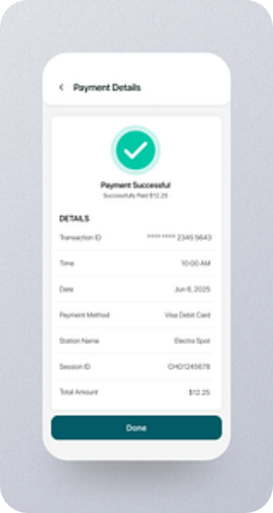
The 6-Step Autopay Journey
01
Register
Customer seamlessly onboards onto the platform.
02
Receive QR
Tamper-proof sticker issued to the vehicle.
03
Scan
Operator effortlessly scans the QR on arrival.
04
Enter Fuel
Operator inputs fuel type and required litres.
05
Auto-Debit
Instant bank debit via RBI-compliant UPI.
06
Receipt
Digital receipt dispatched. Loop done in < 15s.

Slide 7
Why We Win?
Insight: We don't compete on general payments. We compete on "I need to drive out now."
Criteria | CASH & CARDS | STANDARD UPI | ZapPay
Delivery Time (Speed) | 2-4 mins (Change/PIN issues) | 1-2 mins (Network drops) | Sub 15 seconds
Security Strategy | High risk of shrinkage | Manual verification needed | Automated & vehicle-linked
Hardware Needs | Heavy POS requirements | QR Standee & Soundbox | Zero POS hardware
Predictability | Low (Queues vary) | Low (Subject to network) | High (Instant Autopay)
Primary Focus | Legacy transactions | Retail payments | Speed + Habit forming

Slide 8
₹10 Lakhs Pre-Seed to Scale Pilot Playbook
To build the infrastructure and operational density required to own the instant fuel payment habit across Tier-2 cities pan-India.
Phase 1: Pilot (Next 3 Months)
Test in 10-20 pumps in Chhattisgarh and onboard at least 100 dedicated customers in the first month.
Phase 2: Expansion (Next 6 Months)
Replicate success across Tier-2 cities with independent operators, proving the hardware-less model.
Phase 3: Rollout (Next 9 Months)
Launch marketing blitz to target 0.86M litres and ₹4.3L daily revenue at a 0.5% transaction fee.
₹4L
40% Pump Expansion Setup
Onboarding 10-20 prime locations & logistics.
₹4L
40% Operational Cost
Salaries, field team, and inventory management.
₹1L
10% Registration, legalities, onboarding.
Platform scaling and security enhancements.
₹1L
10% Growth & Marketing
Customer acquisition and pilot campaigns.
Customer acquisition and pilot campaigns.

Slide 9


Team ZapPay
Co-Founder 1
Co-Founder 2
CEO | Operations & Strategy
CFO | Finance & Compliance
"Early team member at multiple high-growth startups, contributing to their journey from launch to rapid scale and operations management."
"Chartered Accountant with extensive experience in leading MNCs and independent practice, mastering unit economics and compliance."

Slide 10


Mission: A Zero-Wait, Zero-Cash India.
ZapPay is more than a payment solution; it's a vision to fundamentally transform the fuel retail landscape. We will eradicate queues, empower 85,000 dealers with frictionless digital commerce, and create a vehicle-linked payment identity for every driver.
Every scan strengthens a nationwide ecosystem where fuel, fleet, and finance converge, paving the way for future innovations like carbon credits and personalized loyalty currencies.

